Slide 1
CHAPTER 4
Layered Models
By Simachew M.

Slide 2
Contents to be discussed
  Layer Architecture
  Needs of layered model
  Overview of the OSI reference model
  Peer-to-Peer Processes
Layers In OSI Model
TCP/IP Reference model

Slide 3
  Layer Architecture
many of the networks that were built used different hardware and software implementations,
as a result, they were incompatible and it became difficult for networks using different specifications to communicate with each other.
To address the problem of networks being incompatible and unable to communicate with each other, we need some way of structured model.
A widely accepted structuring technique is layering.
The communications functions are partitioned into a hierarchical set of layers.

Slide 4
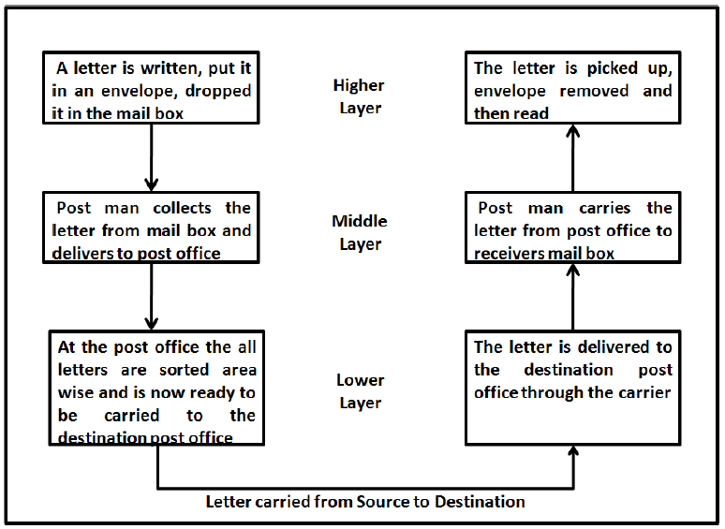
  Needs of layered model
The main objective of a computer network is to be able to transfer the data from sender to receiver.
It can be done by breaking it into small sub tasks, each of which are well defined.
we can call these sub tasks as layers.
every task or job can be done by dividing it into sub task or layers.

Slide 5
Cont.
At the sender site, the activities take place from higher level to lower level.
Higher Layer: The sender writes the letter along with the sender and receivers address and put it in an envelope and drop it in the mailbox.
Middle Layer: The letter is picked up by the post man and delivered to the post office
Lower Layer: The letters at the post office are sorted and are ready to be transported through a carrier.
During transition the letter may be carried by truck, plane or ship or a combination of transport modes before it reaches the destination post office.

Slide 6
Cont.
At the Receiver site, the activities take place
Lower Layer: The carrier delivers the letter to the destination post office
Middle Layer: After sorting, the letter is delivered to the receivers mail box
Higher Layer: The receiver picks up the letter, opens the envelope and reads it.
The activities in the entire task are organized into three layers.
Each activity at the sender or receiver side occurs in a particular order at the hierarchy.
The important and complex activities are organized into the Higher Layer and the simpler ones into middle and lower layer.

Slide 7
  Overview of the OSI reference model
With the rapid growth of networking hardware and software,
a need arose for standard protocols that could allow hardware and software from different vendors to communicate.
The Open Systems Interconnection (OSI) Model was developed by International Organization for Standardization (ISO).
It was developed to allow systems with different platforms to communicate with each other.
It is a network model that defines the protocols for network communications
represents the seven layers of the process by which data is packaged and transmitted from a sending application through the physical wires to the receiving application.

Slide 8
Layers In OSI Model
    Physical Layer
the bottom-most layer.
the physical part of the network that connects network components together.
the layer that actually interacts with the transmission media
involved in physically carrying information from one node in the network to the next.
provide services for the data link layer.
create a signal for a data which represented by 0 and 1 in data link layer.
The transmission medium is a passive entity it is controlled by transmission layer.
The physical layer covers the physical interface between devices and the rules by which bits are passed from one to another.

Slide 9
    Data Link Layer
the data link layer attempts to make the physical link reliable while providing the means to activate, maintain, and deactivate the link.
It provides error detection and control for higher layer.
It is responsible for the reliable transfer of data frames from one node to another connected by the physical layer.
The data link layer divides the stream of bits received from the network layer into manageable data units called frames. 0 frames.
If frames are to be distributed to different systems on the network, the data link layer adds a header to the frame to define the sender and/or receiver of the frame.

Slide 10
Cont.
If the rate at which the data are absorbed by the receiver is less than the rate at which data are produced in the sender, the data link layer imposes a flow control mechanism to avoid overwhelming the receiver.
The data link layer adds reliability to the physical layer by adding mechanisms to detect and retransmit damaged or lost frames.
When two or more devices are connected to the same link, data link layer protocols are necessary to determine which device has control over the link at any given time.

Slide 11
    Network Layer
responsible for the source-to-destination delivery of a packet, possibly across multiple networks (links).
the data link layer oversees the delivery of the packet between two systems on the same network (links),
the network layer ensures that each packet gets from its point of origin to its final destination.
It manages the delivery of individual data packets from source to destination through appropriate addressing and routing.
The network layer adds a header to the packet coming from the upper layer that, among other things, includes the logical addresses of the sender and receiver.
It performs routing functions.

Slide 12
    Transport Layer
The transport layer is responsible for process-to-process delivery of the entire message.
A process is an application program running on a host.
Whereas the network layer oversees source to-destination delivery of individual packets, it does not recognize any relationship between those packets.
ensures that the whole message arrives intact and in order, overseeing both error control and flow control at the source-to-destination level.

Slide 13
    Session Layer
The session layer is the network dialog controller.
It establishes, maintains, and synchronizes the interaction among communicating systems.
The session layer allows two systems to enter into a dialog.
allows a process to add checkpoints, or synchronization points, to a stream of data.
example, if a system is sending a file of 2000 pages, it is advisable to insert checkpoints after every 100 pages to ensure that each 100-page unit is received and acknowledged independently.

Slide 14
    Presentation Layer
defines the format of the data to be exchanged between applications.
defines the syntax used between application entities and provides for the selection and subsequent modification of the representation used.
It monitors syntax and semantics of transmitted information through translation, compression, and encryption.

Slide 15
    Application Layer
provides a means for application programs to access the OSI environment.
This layer contains management functions and generally useful mechanisms that support distributed applications.
It used as an interface between user and applications on the network.
allows a user to access files in a remote host
provides the basis for e-mail forwarding and storage.

Slide 16
  Peer-to-Peer Processes
Within a single machine, each layer calls upon the services of the layer just below it.
Layer 3, for example, uses the services provided by layer 2 and provides services for layer 4.
Between machines, layer x on one machine communicates with layer x on another machine.
This communication is governed by an agreed-upon series of rules and conventions called protocols.
The processes on each machine that communicate at a given layer are called peer-to-peer processes.
Communication between machines is therefore a peer-to-peer process using the protocols appropriate to a given layer.

Slide 17
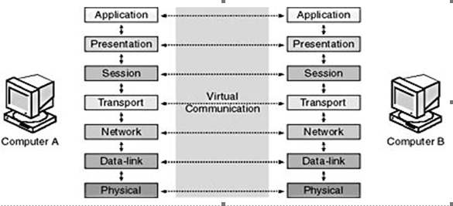
Cont.

Slide 18
TCP/IP Reference model
the network be able to survive loss of subnet hardware, with existing conversations not being broken off.
connections remain intact as long as the source and destination machines were functioning,
even if some of the machines or transmission lines in between were suddenly put out of operation.
The ability to connect multiple networks in a seamless way was one of the major design goals from the very beginning.
The TCP/IP reference model contains four layers instead of seven as in OSI reference model.
It has four layers.

Slide 19
    Network Interface(Access) Layer
The Network Interface Layer (also called the Network Access Layer) is responsible for placing TCP/IP packets on the network medium and receiving TCP/IP packets off the network medium.
encompasses the Data Link and Physical layers of the OSI Model.

Slide 20
    Internet Layer
The Internet Layer is responsible for addressing, packaging, and routing functions. The core protocols of the Internet Layer are IP, ARP, ICMP, and IGMP.
The Internet Protocol (IP) is a routable protocol responsible for IP addressing and the fragmentation and reassembly of packets.
The Address Resolution Protocol (ARP) is responsible for the resolution of the Internet Layer address to the Network Interface Layer address, such as a hardware address.
The Internet Control Message Protocol (ICMP) is responsible for providing diagnostic functions and reporting errors or conditions regarding the delivery of IP packets.
The Internet Group Management Protocol (IGMP) is responsible for the management of IP multicast groups.
The Internet Layer is analogous to the Network layer of the OSI model.

Slide 21
    Transport Layer
responsible for providing the Application Layer with session and datagram communication services.
The core protocols of the Transport Layer are TCP and the User Datagram Protocol (UDP).
TCP provides a one-to-one, connection-oriented, reliable communications service.
TCP is responsible for the establishment of a TCP connection, the sequencing and acknowledgment of packets sent, and the recovery (retransmission) of packets lost during transmission.
UDP provides a one-to-one or one-to-many, connectionless, unreliable communications service.
UDP is used when the amount of data to be transferred is small.

Slide 22
    Application Layer
provides applications the ability to access the services of the other layers and defines the protocols that applications use to exchange data.
The HyperText Transfer Protocol (HTTP) is used to transfer files that make up the Web pages of the World Wide Web.
The File Transfer Protocol (FTP) is used for interactive file transfer.
The Simple Mail Transfer Protocol (SMTP) is used for the transfer of mail messages and attachments.
Telnet, a terminal emulation protocol, is used for remote login to network hosts.
The Domain Name System (DNS) is used to resolve a host name to an IP address.

Slide 23
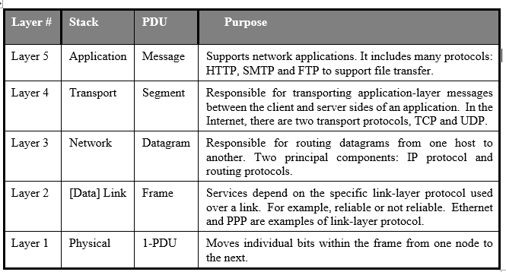
The 5 layers of TCP/IP model

Slide 24
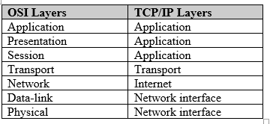
.

Slide 25
.
THE END!
THANKS A LOT FOR YOUR
ATTENSION
?

